Slide 1

Predictive Analysis of Customer Spending Power (Customer Segmentation)
OLS and Bayesian Regression
Team 5:
Anshita Varshney
Bhavnil Patel
Chongli Zhao
Dhairya Sheth
Jyoti Lnu
Ruofan Wu

Slide 2

Business Case
To predict the spending power of the target customers by understanding the trends in the dataset and predicting spending score.

Slide 3

Problem Statement
Understand the likelihood of buying or predicting the customers who are more likely to converge [Target Customers] so that marketing strategies could be designed to cater to those target customers.
Objective
Analyze the dataset to understand the dependency of spending score on available factors: Age, Annual Income, and Gender.
Create 2 models to predict spending score of the target customers (in the available dataset).
Comparative analysis of the two models (Ordinary Least Squares (OLS) with Forward Selection, and Bayesian Linear Regression with PyMC3)
Concluding on target customers from the customer base available in the dataset.

Slide 4
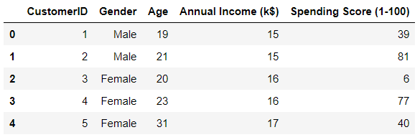
About Dataset
CustomerId: Customer's unique ID
Gender: Customer's gender
Age: Customer's age
Annual Income: Customer's annual income
Spending Score: A score, out of 100, to rate customer's behavior and money spent by the customer.
200 rows of simulated data
Independent Variables | Dependent Variable
Age, Annual Income, Gender | Spending Score

Slide 5
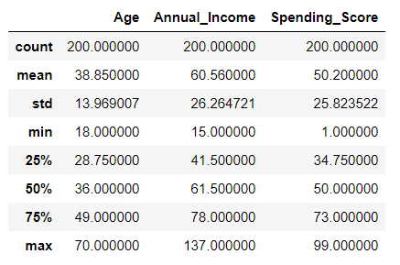
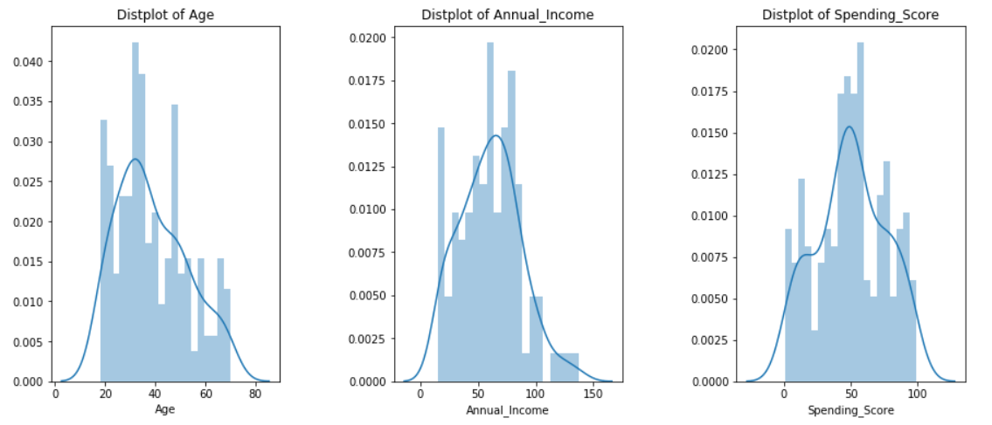
Basic statistical details of the dataset
Dependent variables and independent variables are normally distributed
Dataset looks good to conduct OLS regression
Histogram Plots

Slide 6
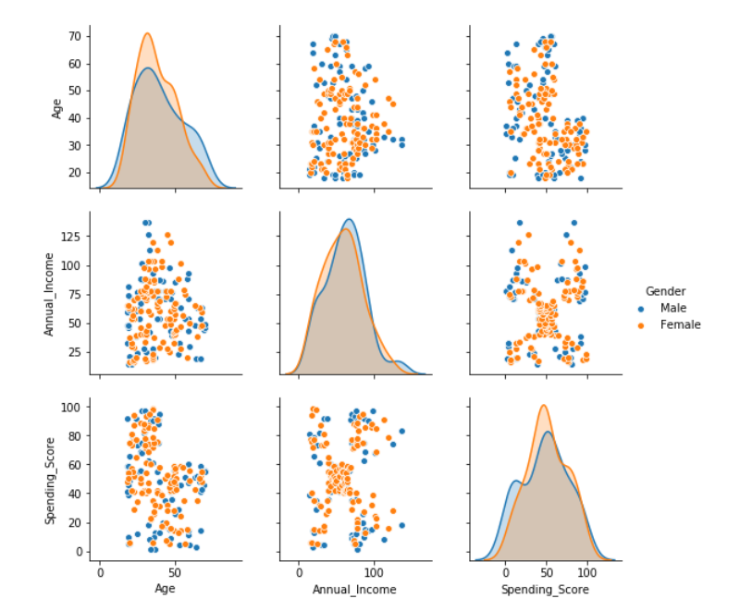
Summary observation on original dataset
We see that Age and Annual Income are not collinear.
There is no direct correlation that can be seen between the spending score and age, spending score and annual income.
Thus, it would be appropriate to do a forward selection to find the combination of independent variables that yield the best results.

Slide 7
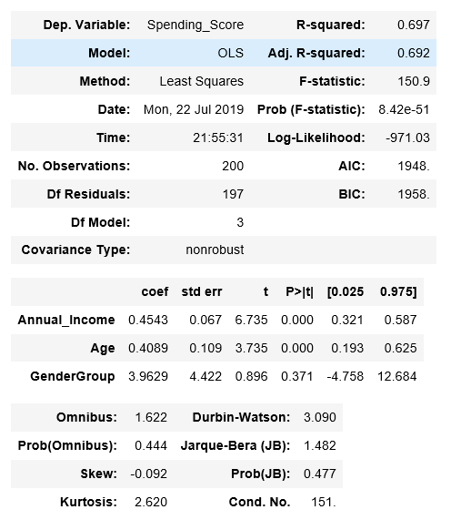
OLS Regression on Initial Dataset

Slide 8
Interpretations from OLS Regression on Initial Dataset
A single linear multivariate regression that models the relationship between the dependent variable and the independent variables returns a low R-squared at around 69.7%
p-value for Gender Group is high (>0.05) showing that changes in predictor variable (Gender Group) are not associated with changes in the response variable (spending score). Since, Gender Group is not a significant factor for the change in spending score, we will rerun the model after dropping Gender Group from our model.
Intercept can be excluded as no annual income suggests no spending power/score.
Age Grouping: 6 Age Groups: Below 25, 26 – 35, 36 – 45, 46 – 55, 56 – 65, Above 65

Slide 9

Model Building
Models:
OLS with Forward Elimination
Bayesian Regression using PyMC3

Slide 10
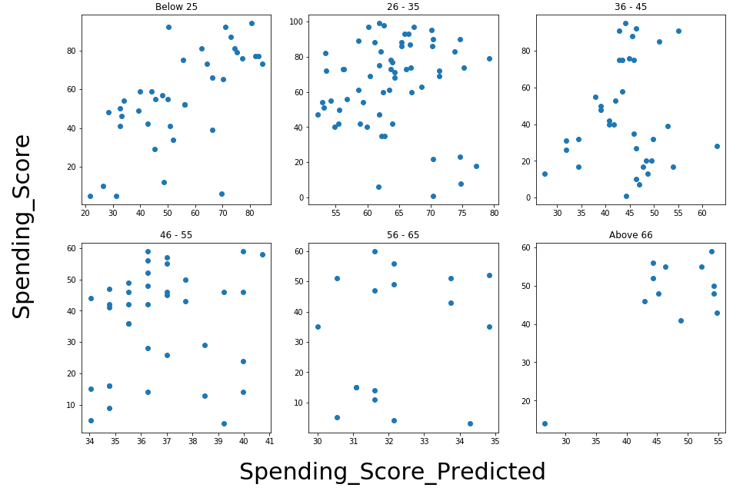
Model I – OLS using Forward Elimination
We applied a forward elimination on the linear multivariate regressions on each age group to select the combinations of independent variables that yield highest R-squared.
Predicted vs Actual Spending Score

Slide 11
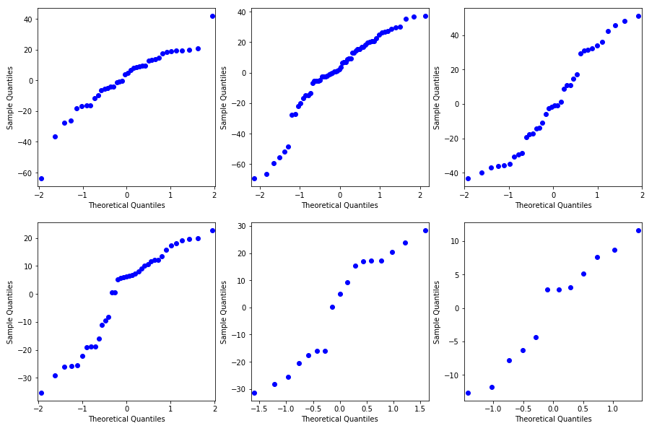
Model I – OLS using Forward Elimination
The residuals are along the diagonal, which shows normal distribution of residuals. The residuals are nearly normally distributed & centered on 0.

Slide 12
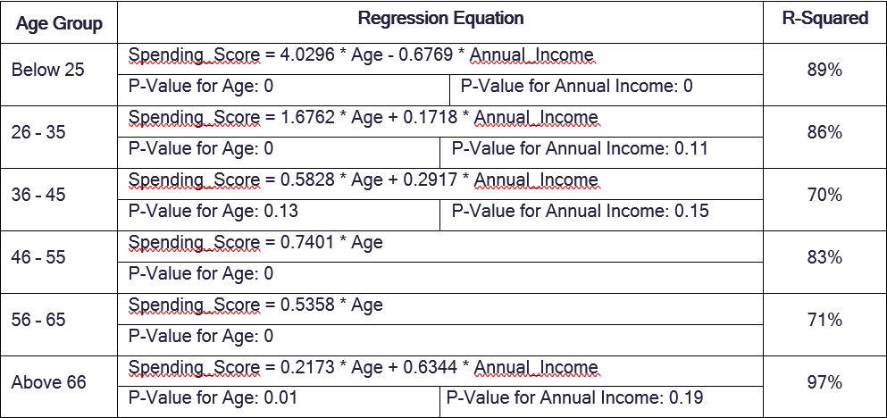
Model I – OLS using Forward Elimination Results

Slide 13



Model I - Observations
OLS with Forward Elimination
R-squared for regression on each age group improve significantly after splitting data into Age Groups and doing forward selection.
Some independent variables have p-value higher than 5%, suggesting that they are not a significant determinant for the spending_score. However, we argue that including those variables gives us the best predicting power as combining them with other variables yield highest R-squared.
Annual_Income is negatively correlated with the spending_score for customers below 25.
Annual_Income does not seem to have any relationship with the spending_score for customers between 46 years old to 65 years old.
There are not many data points for the age group above 56 (56-65 and above 66). Therefore, the regression results in these two groups could change significantly with more data collection.

Slide 14
Model II – Bayesian Linear Regression using PyMC3
We did Regression modelling in the Bayesian framework and carried out inference using the PyMC3 MCMC library.
We do this primarily because:
We have a limited dataset
Some facts may be more likely than others, but that information may not be contained in the data we are using for modeling.
We are interested in knowing how likely certain facts are
Critical Advantages of Bayesian estimation:
Priors: We can quantify any prior knowledge we might have by placing priors on the parameters.
Quantifying uncertainty: We do not get a single estimate of β but instead a complete posterior distribution about how likely different values of β are.

Slide 15
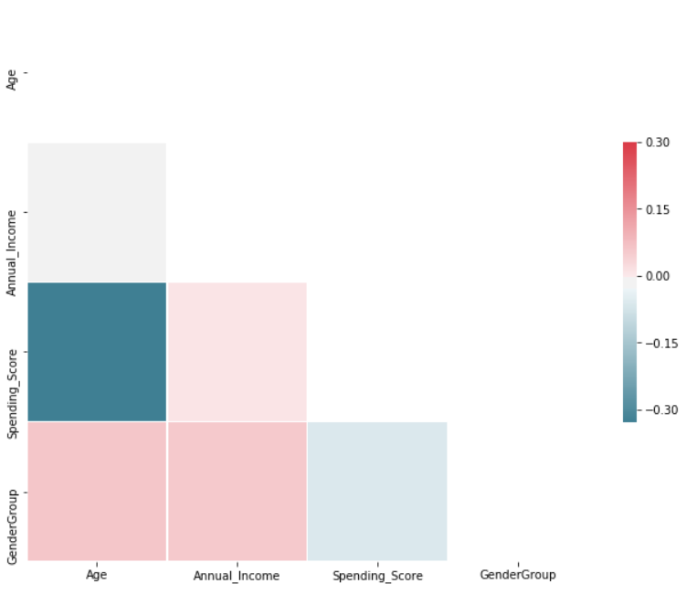
Model II – Data Analysis - Heatmap
Heatmap

Slide 16
Model II – Create Model in PyMC3 and Sample from Posterior
We built the model using the formula 'Spending_Score ~ Age + Annual_Income' as evident from heat map, and a normal distribution for the data likelihood. Then, we let a Markov Chain Monte Carlo algorithm draw samples from the posterior to approximate the posterior for each of the model parameters. We let GLM module from PYMC3 to choose default priors.
The sampling algorithm chosen by PYMC3 module is NUTS sampler i.e. No U-turn Sampler.
We draw 20000 sample with 2 chains and run the GLM model for the formula: Spending_Score ~ Age + Annual_Income -1. We remove the intercept.
We run this algorithm with 6 age groups as identified before (below 25, 26 – 35, 36 – 45, 46 – 55, 56 – 65, Above 65) and compared the results obtained.

Slide 17
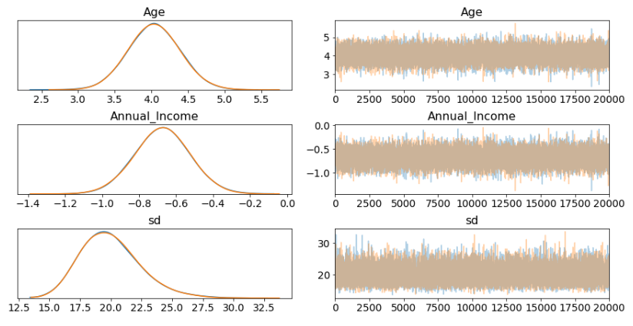
Model II – Examining Bayesian Linear Regression Traceplots
Bayesian inference does not give us only one best fitting line (as maximum likelihood does) but rather a whole posterior distribution of likely parameters.
The left side of the traceplot shows the marginal posterior:
X-Axis: The values for the variable
Y-Axis: The probability for the variable (as determined by sampling)
The different colored lines indicate that we performed two chains of Markov Chain Monte Carlo.
From the left side we can see that there is a range of values for each weight.
The right side shows the different sample values drawn as the sampling process runs.
There are a couple of things to see here:
Our sampling chains for the individual parameters (left side) seem well converged and stationary (there are no large drifts or other odd patterns).
The maximum posterior estimate of each variable (the peak in the left side distributions) is very close to the true parameters used to generate the data (x is the regression coefficient and sigma is the standard deviation of our normal).
Age Group: Below 25

Slide 18
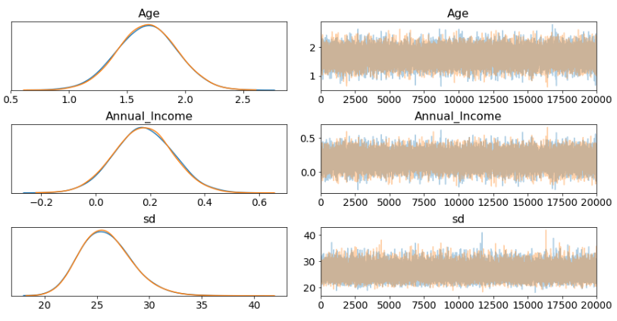
Model II – Examining Bayesian Linear Regression- Traceplots
Age Group: Below 25
Age Group: 26 - 35

Slide 19
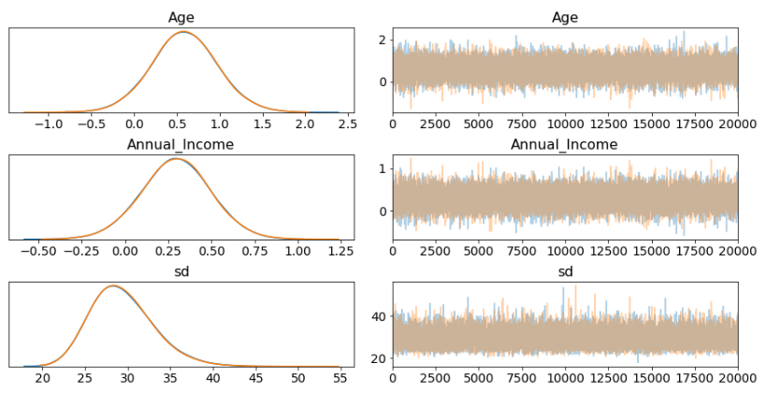
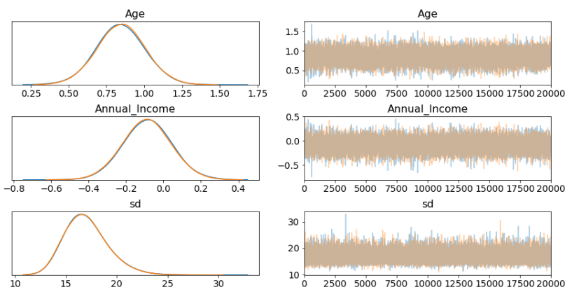
Model II – Examining Bayesian Linear Regression- Traceplots
Age Group:
36 - 45
Age Group: 46 - 55

Slide 20
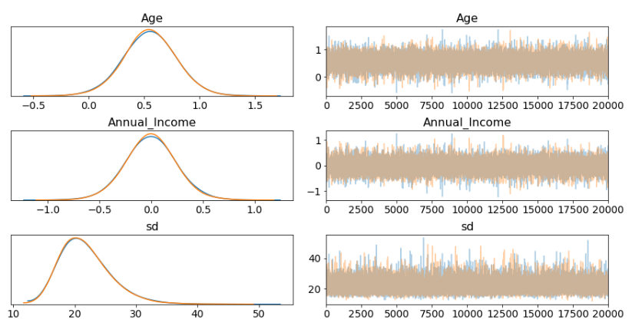
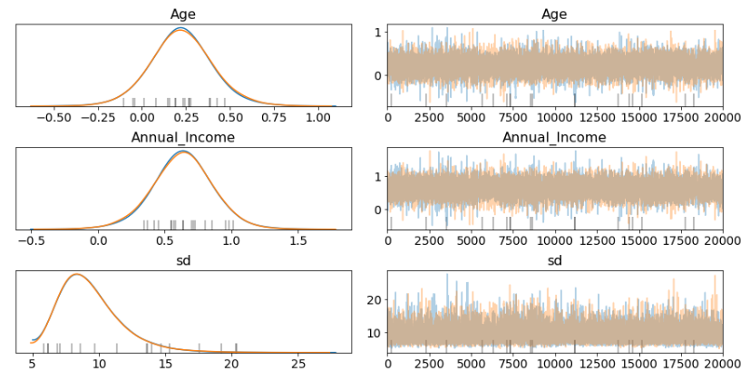
Model II – Examining Bayesian Linear Regression- Traceplots
Age Group:
56 - 65
Age Group: Above 65

Slide 21
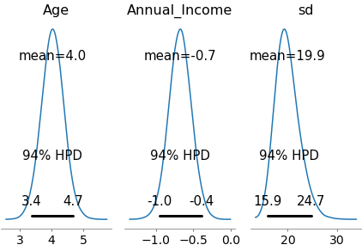
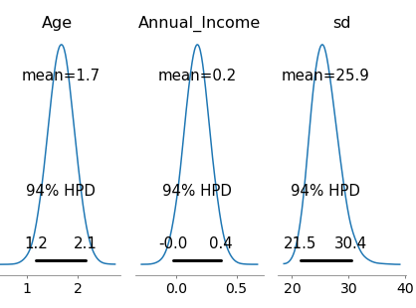
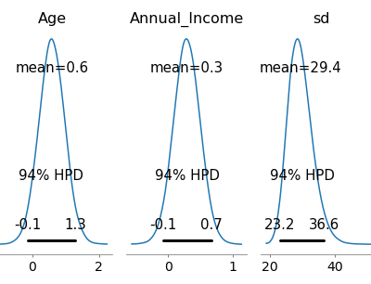
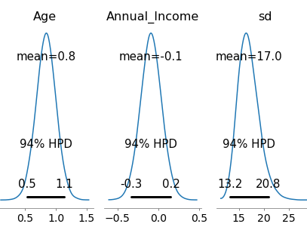
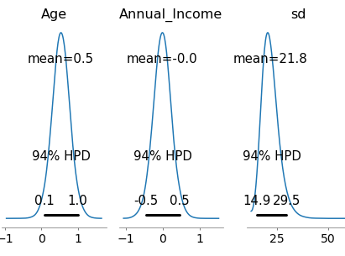
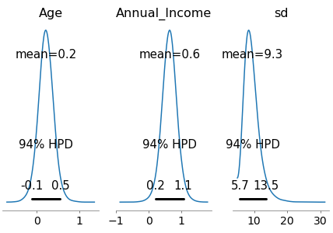
Model II – Examining Bayesian Linear Regression Results
Age Group: Below 25
Age Group: 26 - 35
Age Group: 36 - 45
Age Group: 46 - 55
Age Group: 56 - 65
Age Group: Above 65

Slide 22
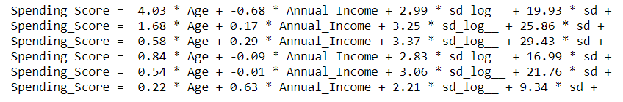
Model II - Interpretations
Bayesian Linear Regression
Based on the sign and location of the weights, we can make the following inferences regarding the features in our dataset:
Based on Age Group, Below 25, Age seems to have positive relation with spending score while Annual income has negative impact.
In Age Group between 26-45, both Age and Annual income have positive impact on spending score.
When we go further down the Age Group with ages 56-65, we see a positive impact of age on spending score while annual income is negative.
In Age Group, above 66, both the factors have positive impact on age.
Below 25:
26 – 35:
36 – 45:
46 – 55:
56 – 65:
Above 65:

Slide 23
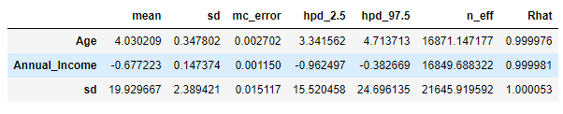
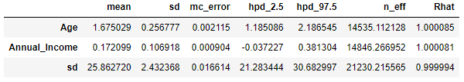
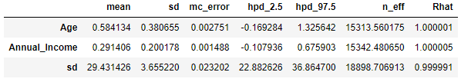
Model II – Summary of MCMC Model for Different Age Groups
Age Group: Below 25
Age Group: 26 - 35
Age Group: 36 - 45

Slide 24
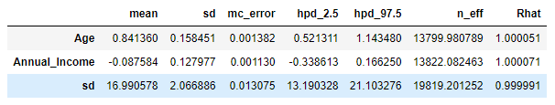
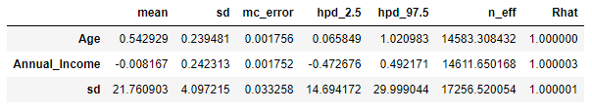
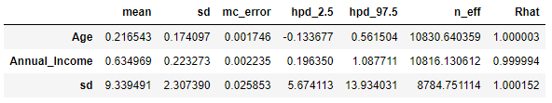
Model II – Summary of MCMC Model for Different Age Groups
Age Group: 46 - 55
Age Group: 56 - 65
Age Group: Above 65

Slide 25
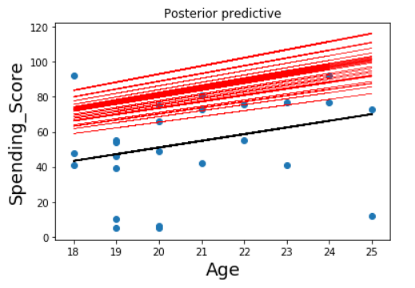
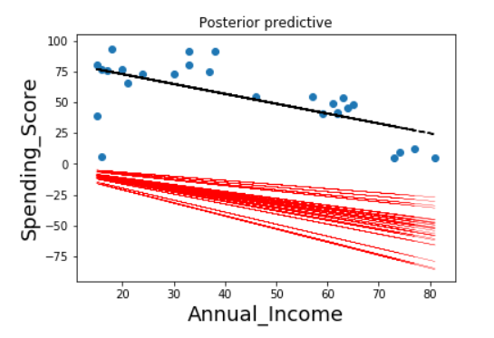
Model II – Prediction of Response
We create the posterior plots which provide insight into the sample’s posterior predictive regression lines.
In the GLM we do not only have one best fitting regression line, but many. A posterior predictive plot takes multiple samples from the posterior (intercepts and slopes) and plots a regression line for each of them.
Estimated regression lines are very similar to the true regression line. But since we only have limited data, we have uncertainty in our estimates, here expressed by the variability of the lines.
Age Group: Below 25

Slide 26
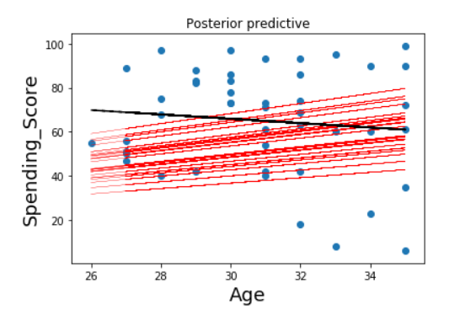
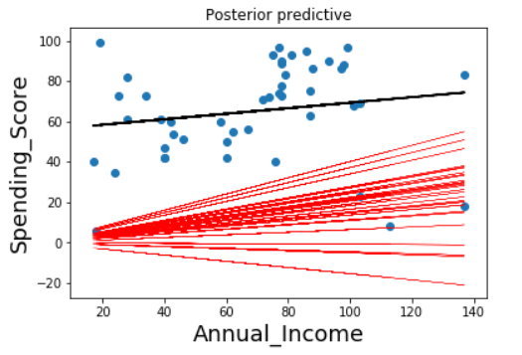
Model II – Prediction of Response
We create the posterior plots which provide insights into the sample’s posterior predictive regression lines.
Age Group: 26 - 35

Slide 27
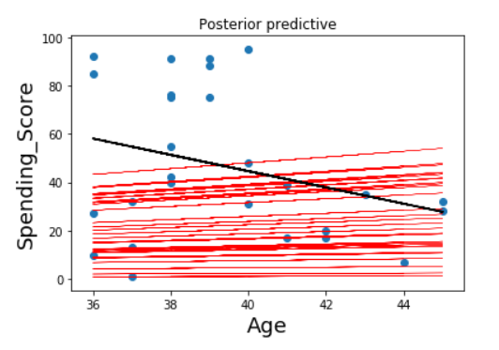
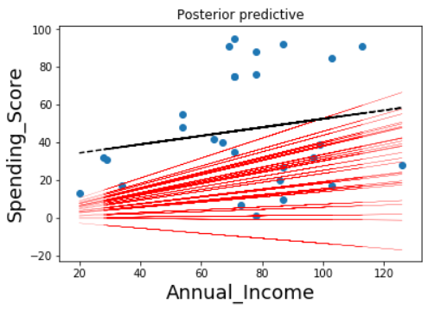
Model II – Prediction of Response
We create the posterior plots which provide insights into the sample’s posterior predictive regression lines.
Age Group: 36 - 45

Slide 28
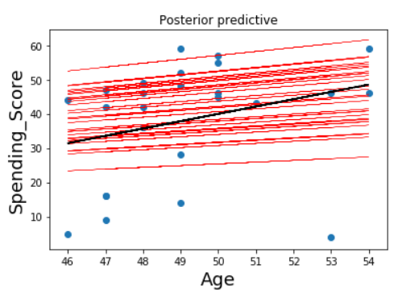
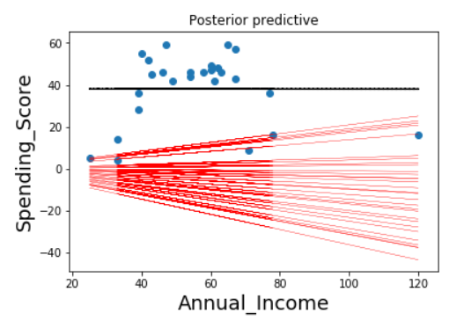
Model II – Prediction of Response
We create the posterior plots which provide insights into the sample’s posterior predictive regression lines.
Age Group: 46 - 55

Slide 29
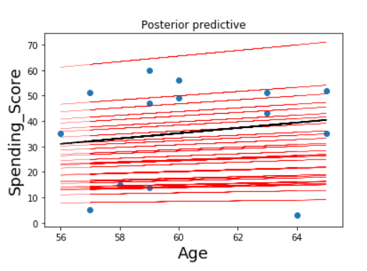
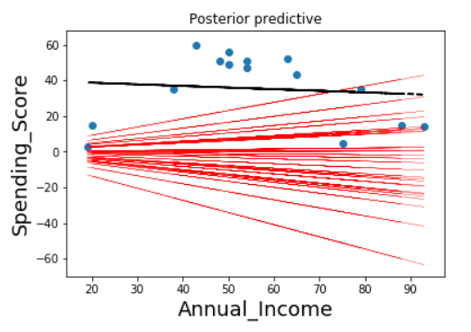
Model II – Prediction of Response
We create the posterior plots which provide insights into the sample’s posterior predictive regression lines.
Age Group: 56 - 65

Slide 30
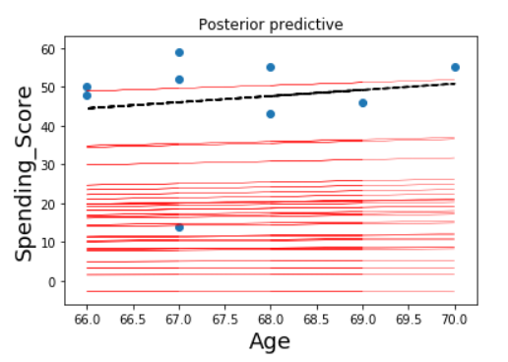
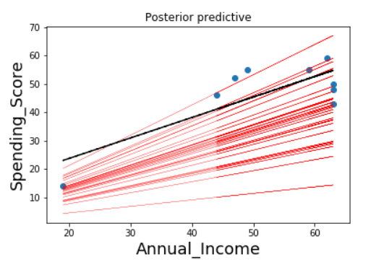
Model II – Prediction of Response
We create the posterior plots which provide insights into the sample’s posterior predictive regression lines.
Age Group: Above 65

Slide 31
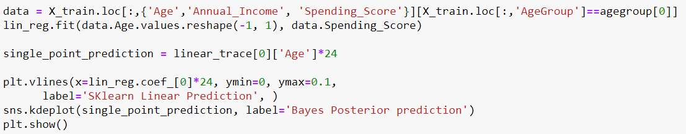
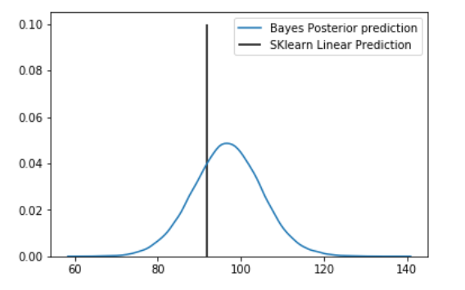
Model II – Prediction for Single Point
Below is the point prediction (for Age = 23, using Bayesian Regression. We see that Bayesian prediction mean value almost coincides with the linear regression output. The data should be rich enough to predict correctly.

Slide 32
Comparison of the two models’ results
OLS with Forward Regression Vs Bayesian Regression
As we can see from above, coefficients from both regression models are very close. Below is a summary of comparison:
Below 25 Age Group: Coefficient for Age from OLS is 4.0296, which is very close to Age coefficient of 4.03 from Bayesian Regression. Coefficient for Annual Income from OLS is (-0.6769), which is very close to the -0.6769 value from Bayesian Regression. Overall, shows a very similar dependency on Age and Annual Income in this group.
26 – 35 Age Group: Coefficient for Age from OLS is 1.6762, which is very close to Age coefficient of 1.68 from Bayesian Regression. Coefficient for Annual Income from OLS is 0.1718, which is very close to the 0.17 value from Bayesian Regression. Overall, shows a very similar dependency on Age and Annual Income in this group.
36 – 45 Age Group: Coefficient for Age from OLS is 0.5828, which is very close to Age coefficient of 0.58 from Bayesian Regression. Coefficient for Annual Income from OLS is 0.2917, which is very close to the 0.29 value from Bayesian Regression. Overall, shows a very similar dependency on Age and Annual Income in this group.
46 – 55 Age Group: Coefficient for Age from OLS is 0.7401, which is only different from Age coefficient of 0.84 from Bayesian Regression by 0.09 units. OLS regression for this age group does not use Annual Income as one of the independent variables, determined by forward selection. However, in Bayesian Regression we have used both age and annual income. Coefficient for Annual Income is -0.09 from Bayesian Regression, indicating a very minimal and a negative dependency of spending score on annual income. Overall both models show very similar results.
56 – 65 Age Group: Coefficient for Age from OLS is 0.5358, which is very close to Age coefficient of 0.54 from Bayesian Regression. OLS regression for this age group does not use Annual Income as one of the independent variables, determined by forward selection. However, in Bayesian Regression we have used both age and annual income. Coefficient for Annual Income is -0.01 from Bayesian Regression, indicating a very minimal and a negative dependency of spending score on annual income. Overall, both models show very similar results.
Above 65 Age Group: Coefficient for Age from OLS is 0.2173, which is very close to Age coefficient of 0.22 from Bayesian Regression. Coefficient for Annual Income from OLS is 0.6344, which is very close to the 0.63 value from Bayesian Regression. Overall, shows a very similar dependency on Age and Annual Income in this group.

Slide 33
Thank You
Anshita Varshney
Bhavnil Patel
Chongli Zhao
Dhairya Sheth
Jyoti Lnu
Ruofan Wu

Slide 34
References
https://towardsdatascience.com/markov-chain-monte-carlo-in-python-44f7e609be98
https://www.quantstart.com/articles/Bayesian-Linear-Regression-Models-with-PyMC3
https://www.quantstart.com/articles/Markov-Chain-Monte-Carlo-for-Bayesian-Inference-The-Metropolis-Algorithm
https://towardsdatascience.com/bayesian-linear-regression-in-python-using-machine-learning-to-predict-student-grades-part-2-b72059a8ac7e
http://people.duke.edu/~ccc14/sta-663-2016/16C_PyMC3.html
https://people.duke.edu/~ccc14/sta-663/PyMC3.html

